Slide 1
Cajon Computer Society
Welcome

Slide 2
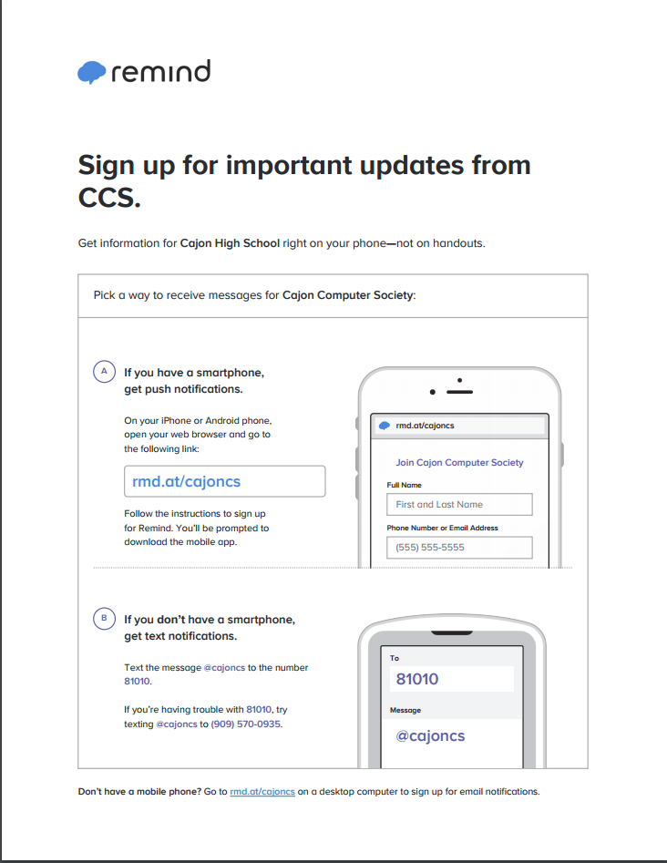
Remind
Text “@cajoncs” to 81010

Slide 3

Google Drive
http://goo.gl/GekoKX
Join our drive for important information

Slide 4

Discord
If you want extra help join the club’s discord
We may also hold online meetings here
https://discord.gg/J9BmEDT

Slide 5

Github
Github is used for version control
Also for open source
https://github.com/

Slide 6
Website
Check out our website
https://cajon-computer-society.github.io/ or http://ccs.kar.moe/

Slide 7

What is programming?
Programming is writing code for a specific program you want to write.

Slide 8
Why should I learn?
Can create anything you want
Helps later in life
If you are interested in computer science, this is it.

Slide 9

What will we be learning?
We will be going over the Python3 programming language
We may also cover some web development.

Slide 10
When are the meetings?
The meetings will be every Tuesday unless we say otherwise via Remind.
We will always send out Remind messages the day of a meeting
We will also have online meetings, which we will send out Remind messages for.

